Slide 1

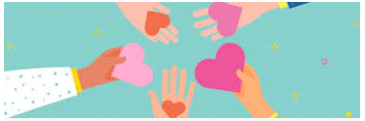
Today’s assembly is about

Slide 2
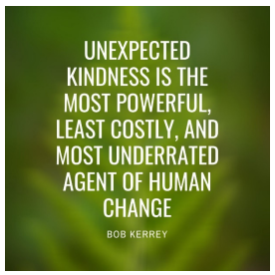
Kindness is one of the most powerful ways we show that we love and care, for ourselves, others and the natural world. The Gospels show many examples of Jesus showing kindness to all in society. Sometimes a simple act of kindness can be transformational.

Slide 3
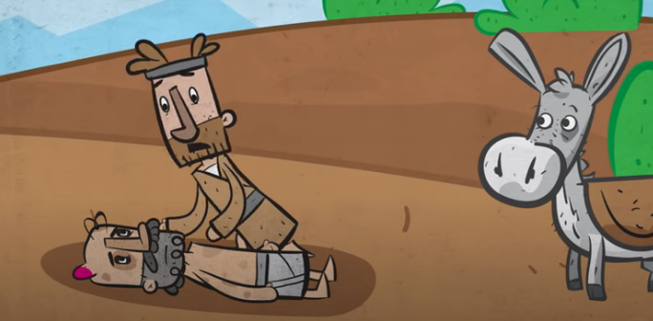
The Parable of the Good Samaritan (Luke 10: 25-37)
https://www.youtube.com/watch?v=osfQg4yKtq8

Slide 4
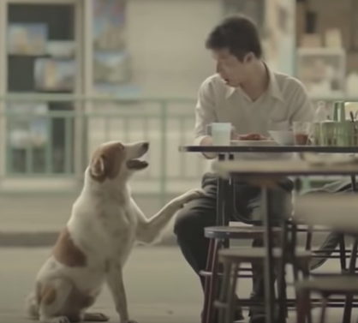
And Jesus concluded, “In your opinion, which one of these three acted like a neighbour toward the man attacked by the robbers?”
The teacher of the Law answered, “The one who was kind to him.”
https://www.youtube.com/watch?v=GdYJr03eJjE&feature=youtu.be

Slide 5
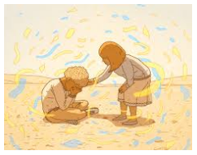
THINK: Can you think of a time when someone was unexpectedly kind to you? Maybe it changed your life?

Slide 6
PRAY:
Be thankful for those who have shown you kindness. Think of others as you say these words:
May you feel safe, May you feel happy, May you feel healthy, May you live with ease.
And be kind to yourself as you say:
May I feel safe, May I feel happy, May I feel healthy, May I live with ease.
Finally ask for guidance and strength to be kind today, and eyes to see where kindness is needed.

