Slide 1
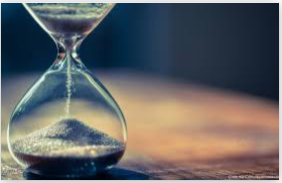
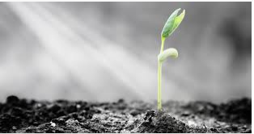
Today’s assembly is about
Patience

Slide 2
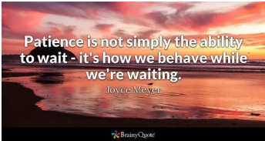
Patience is one of those qualities that we all need to develop especially when times are tough, when people and governments are frustrating. Patience to wait for the right time, patience with each other and the patience to wait on God when things seem to be taking so long to sort themselves out. The Bible is filled with stories of people like Mary, David, Moses and Noah who had to wait for the right time, for God’s time.

Slide 3
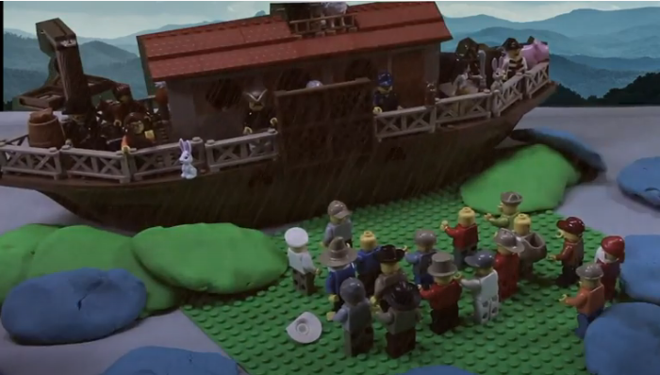
The story of Noah (Genesis 8 verses 6-13)
https://www.youtube.com/watch?v=t-qRm5lOKGU

Slide 4
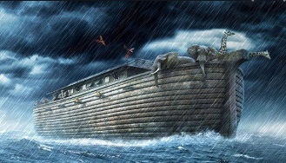
I wonder what made Noah most frustrated?
I wonder what helped Noah to be patient?
If you had been in the ark, what would have made you impatient, and what would you have done about it?
I wonder… if you have to feel patient, or if you can choose to be patient?
I wonder how you cope when you need to be patient – maybe not cooped up in an ark, but maybe in a car on a long journey, or through lockdown?

Slide 5

Have you seen pictures like this in people’s windows?
Why do you think a rainbow was chosen as a symbol at this time?

Slide 6
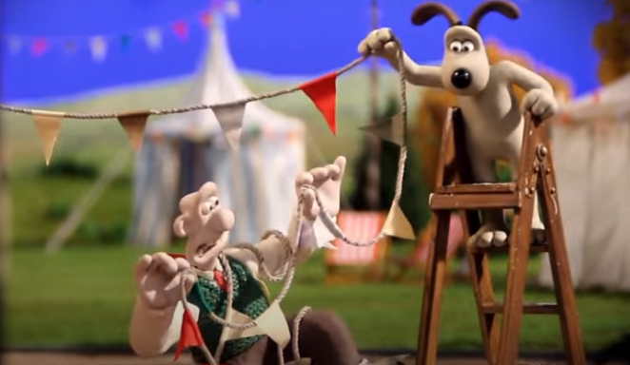
https://www.youtube.com/watch?v=i3CEE9xKKZc
Key Stage 1
It took 6 weeks to make a 1 minute Wallace and Gromit film.
Imagine how patient the film makers had to be.

Slide 7
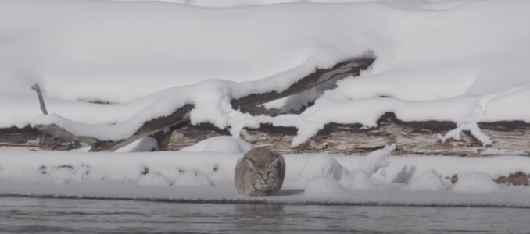
https://www.youtube.com/watch?v=sxYvbtE4Ybs
Key Stage 2
Imagine how patient this film maker had to be.

Slide 8
Key Stage 2
Patience is required in a variety of situations.
Patience with ourselves - not giving up, coping with temper, recognising our strengths and weaknesses, not being too hard on ourselves because we all make mistakes.
Patience with others - recognising everyone is different, learning to make allowances for others, giving time to people, walking at another's pace and not rushing them.
Patience with circumstances - 'Rome wasn't built in a day', doing something worthwhile can take time, taking the long view, 'instant everything' isn't the answer to every problem.
Patience with nature/the world - learning to wait for things to grow (harvest); working for change is one step at a time (for example, climate change); the more complex the problem is, the more time and attention it needs before a solution can be found.

Slide 9
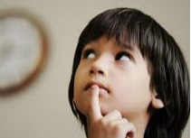
Father God, Sometimes we find it difficult to be patient. We don’t always understand why sometimes things take so long to get sorted out. We want life to get back to normal, and that hasn’t happened yet. Help us to be patient and trust you. Sometimes we get so frustrated by the people around us. Help us to be patient and love them. Amen

