Slide 1
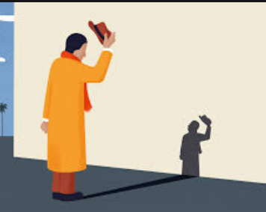
Today’s assembly is about humility

Slide 2
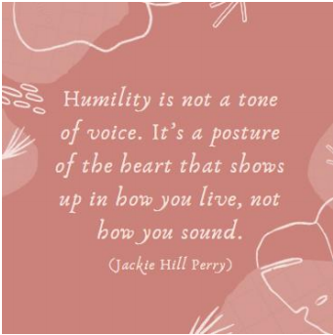
We live in a world where some people say: “look at me, look at me”, chasing after fame and wanting to be noticed. Yet the real heroes (as we have seen over the last few weeks) are the everyday people who care and think of others. Many Christians across the world believe that Jesus is a ‘Servant King’ – one who both showcased and valued humility, calling others to follow his example, too. Being humble means having a realistic picture of ourselves – to be mindful of the times we do amazing things (wow!), the times we fail (ow!) - and seeks to build others up, rather than looking for fame or recognition.

Slide 3
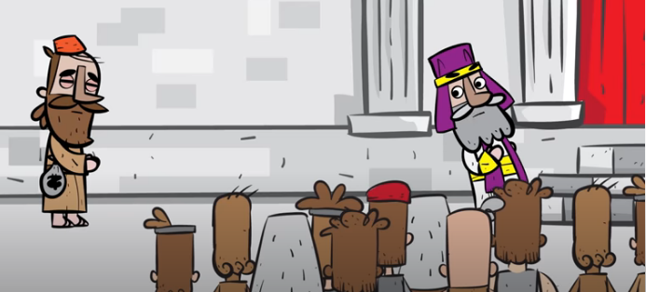
The Parable of the Pharisee and the Tax Collector (Luke 18: 9-14)
‘For those who make themselves great will be humbled, and those who humble themselves will be made great’ (Luke 18: 14)
https://www.youtube.com/watch?v=YWK2edNPPXE

Slide 4
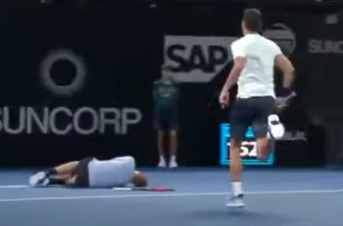
https://www.youtube.com/watch?v=Sd0EEHTJFgc
Key Stage 1
How did the tennis player who helped do the right thing?
What would have been the wrong thing to do?
What would you do if some one you were playing against got hurt?

Slide 5
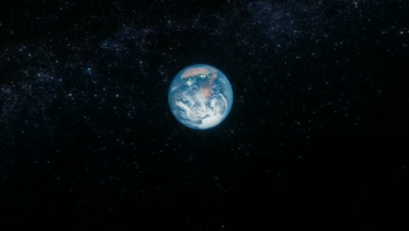
https://www.youtube.com/watch?v=GO5FwsblpT8
Key Stage 2
Sometimes we just need to be full of wonder, to see ourselves as small in a vast and beautiful world and universe – so take time to be small – but special because we are part of it all! Humility is a looking outwards with wonder and awe at the gift of everything that isn’t ‘me’. Take time to consider how special and wonderful we all are, and yet so tiny!

Slide 6

Do we sometimes like to show off? Do we like to be the centre of attention?
Do we like to show that we are better than others?
How we might acknowledge our imperfections this week?
How we might build others up this week, putting them before ourselves?
Key Stage 2

Slide 7
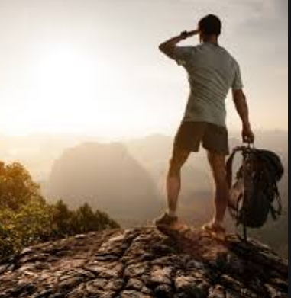
PRAY: Loving God, you know we are not perfect. You see our mistakes and you know our thoughts and you know how great we sometimes want to be. Help us to take our eyes off the wonder of ourselves, looking at the wonder of others instead. Help us to see greatness in everyone, seeing your life within each person we meet. Amen.

