Slide 1

Today’s assembly is about
KEY CONCEPT/MESSAGE: Love is a verb! The Bible teaches that Jesus calls his people to love others through their actions and words.

Slide 2
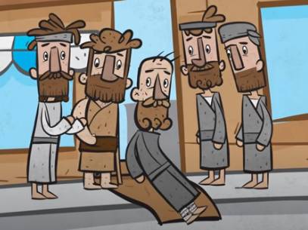
Healing of the paralysed man Luke 5: 17-26
https://www.youtube.com/watch?v=8cmppSIQUX4

Slide 3
Who showed love in this story?
How did they show love to another person?
What was easy? What was difficult?

Slide 4

What do these pictures make you think of? How might it be possible to share or give love away?
Key Stage 1

Slide 5
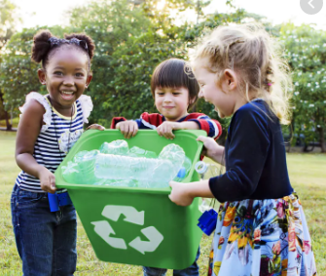
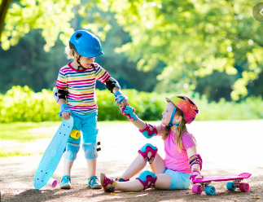
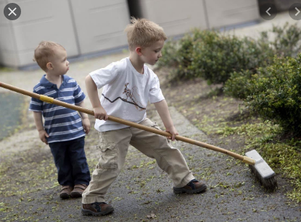
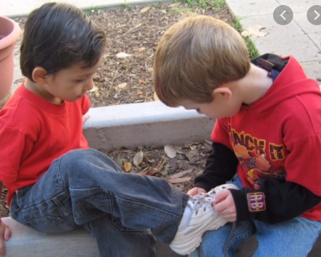
Which children here are giving love away?
Key Stage1

Slide 6

https://www.youtube.com/watch?v=t-29WLQ3trA
Key Stage 2
Listen to this song and then try to explain its message
in your own words.

Slide 7
The love God wants us to have isn’t just an emotion but a conscious act of the will – a deliberate decision on our part to put others ahead of ourselves. This is the kind of love God has for us.” Billy Graham
Key Stage 2
Can you think of a time when you deliberately
decided to put someone ahead of yourself?
What did you do?
How did it feel?

Slide 8
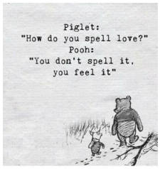
PRAY: Dear God, we thank for Jesus, the gift that showed your love for us. Help us to share and show this love with others, even when it is difficult. Help us to love those who are difficult to love. Guide us to people who need to know your love. Amen

