Slide 1

Our assembly today is about
Courage is often about continuing to do what you would normally do even when faced with extraordinary situations. Many Christians believe that God asks us to offer our skills, talents and abilities in the face of adversity, and that he will use that courageousness to achieve great things.

Slide 2
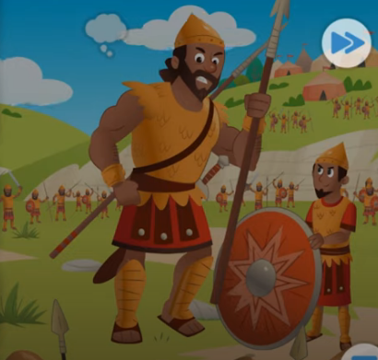
https://www.youtube.com/watch?v=_VCHO50wOE0
Listen to the story of David and Goliath

Slide 3
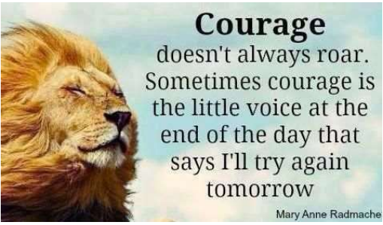
How was David like this? Who could be the “little voice” ?
Can you think of a time when you have thought to yourself “I’ll try again tomorrow”?

Slide 4
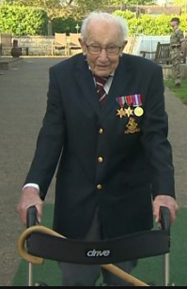
https://www.bbc.co.uk/news/uk-england-beds-bucks-herts-52333127
Key Stage 1
What did Captain Tom Moore do?
How did he show courage?

Slide 5
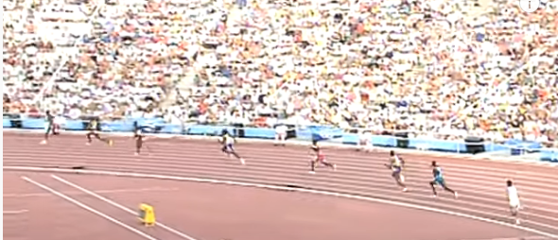
Key Stage 2
WATCH: Derek Redmond’s Olympic Story
https://www.youtube.com/watch?v=t2G8KVzTwfw
Derek Redmond didn’t win a medal at the 1992 Olympic games
in Barcelona, but he did bring 65,000 spectators to their feet in a
standing ovation recognising his incredible act of courage. Derek
Redmond found courage in himself but also through the support
of his father.

Slide 6
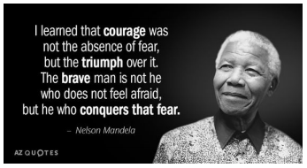
Key Stage 2
Do you agree with Nelson Mandela’s definition of courage? How is it different from what other people say about courage?

Slide 7
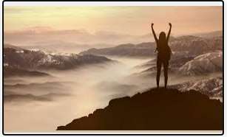
PRAY: Dear God, you know that I sometimes feel frightened at the moment. Frightened about what will happen to me, to those I love and to our school community. But I know that you have been with me, I know that you will be with us today and I know that you will be with me in the future. Give me courage to do the big things, the little things and the difficult things that will make a difference to someone else today. Amen

