Slide 1
Sometimes it can be hard to have hope, especially in difficult or worrying times. However, Christians believe that Jesus teaches about hope as something that can grow, with encouragement and faith. Hope is to be shared.
Tuesday 9th June 2020
Today’s Assembly is all about
HOPE

Slide 2
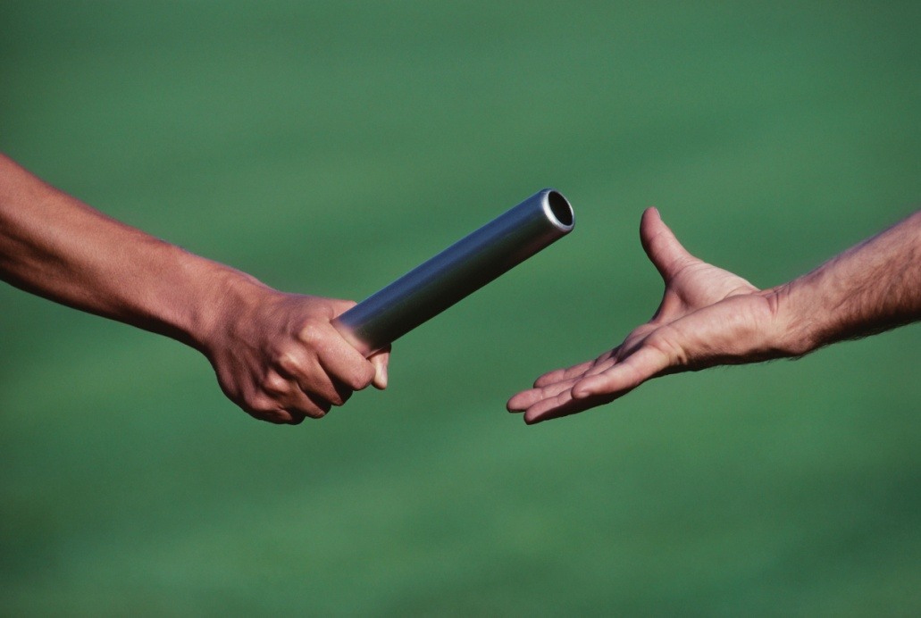
EVERYONE CAN BE A HOPE CARRIER ‘Hope is a baton, something to be held onto but also passed on. Hope comes to us… to flow through us.’

Slide 3
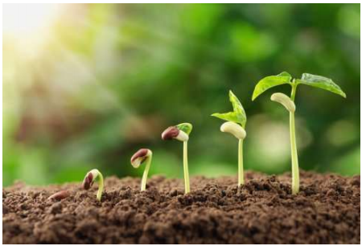
The Parable of the Mustard Seed
(Matthew 13:31-32)
‘The smallest of seeds… becomes a tree.’
https://www.youtube.com/watch?v=sYmRj3s6JLE

Slide 4
What does this picture make you think of? How might it be possible for this plant to be growing here? What makes hope grow in difficult situations?

Slide 5
For KS1
Act out making yourself into a tiny seed – as small as you can possibly squish yourself. Now stretch up as tall as you can, like the tallest tree you have ever seen.
This is what hope is like. It starts really small. We only need a tiny bit to get going. Seeds are hope carriers.
If we keep hold of our hope it starts to grow… little by little… until before we know it, it’s grown into something huge – like an enormous tree!
I wonder, what are you hoping for right now?

Slide 6
For KS2
What do you think is happening in this picture? Who do you think this man is?
Watch this news item to find out more: https://www.bbc.co.uk/news/av/uk-england-leeds52213388/coronavirus-grimsby-teacher-delivering-dozens-oflunches-a-day
How is he being a hope carrier?
How could you be a hope carrier?

Slide 7
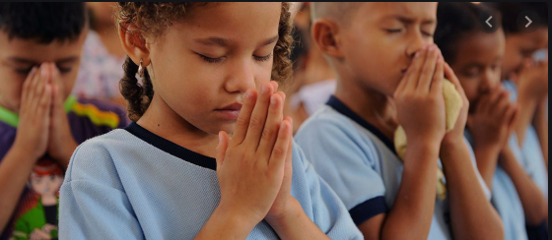
Dear God, we thank you for giving us hope when
we feel worried, when we are having a hard
time, when we don’t know what’s ahead of us
and when we are sad. Thank you that even the
smallest seed of hope can grow into a big, tall
tree. Please help us when we find it hard to be
hopeful, so we can offer hope to others. Amen

